Slide 1
Restaurant Management System
Presented by
DEEPTHISREE KONDURU - R170269
Guided By:
Poovaragavan

Slide 2
OUTLINE
Abstract
Problem Statement
Proposed System/Solution
System Architecture
Conclusion
References
Future Scope

Slide 3
Abstract
“Restaurant Management System” is a web based portal for customers complaining about restaurant issues. Where a customer can raise a ticket about an issue in restaurant and admin can assign a work for raised ticket to the employees. This portal is fully user controlled where a user can raise a complaint and user can see the status of the issue. The admin can be any registered user. He can control all the activities in the portal. He is responsible for assigning the complaints to employees that is raised by customer. This portal is designed for the hostel students to complaint about the issues related to hostel. This portal is user friendly to the customers. We can conclude that our proposed model produced the highest accuracy while using .NET technology to build web based portal to complaint about issues in hostel.

Slide 4
Problem Statement
The Restaurant Management System is developed for automating the complaints of Restaurant. The software will be the great relief to the users The software will help user in case of complaints and see the status of the complaints and create as many as request is possible and can delete or edit the request .The aim of Restaurant Management System is to carry out the complaints of restaurant in an efficient way. It will take the operations of Restaurant complaints to an upper level by providing faster access to data and allowing to create, delete ,edit and assign the work to the person . In existing system there is lot of manual work to overcome this we use .NET technology to build a website.

Slide 5
Proposed Solution
The project is aimed at developing a system for keeping records and showing information about restaurant issues. The system will help the restaurant office to be able to manage the problems of the restaurant. It will shows the complaints raised by customer to admin so that admin can assign work to the respected employees and they can see the work assigned to them.

Slide 6
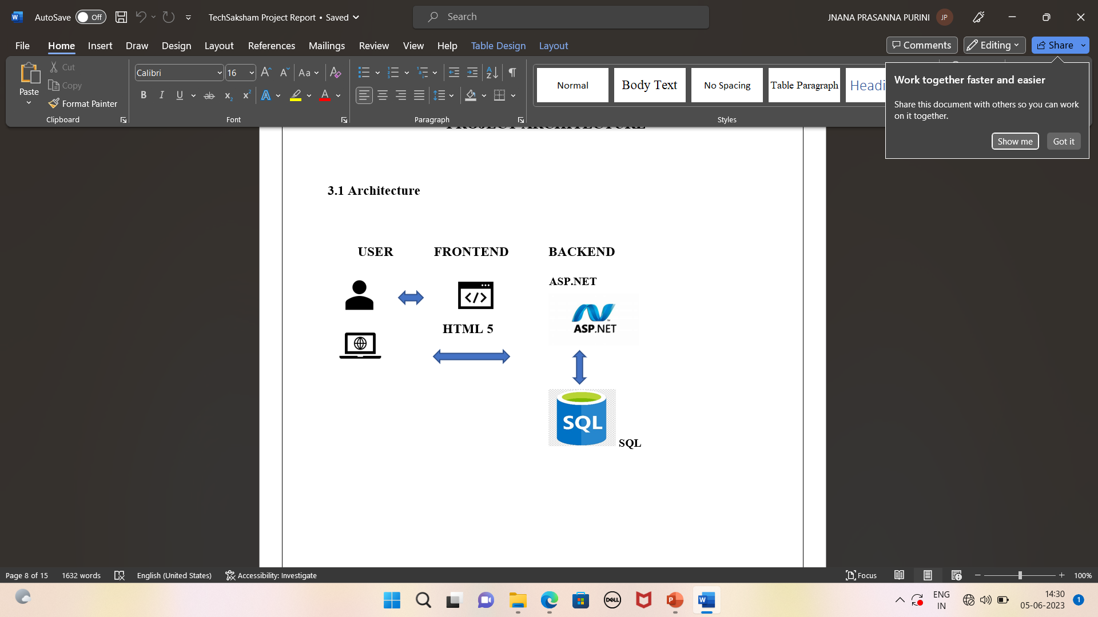
System Architecture

Slide 7
Conclusions
The Restaurant Management System helps your organization improve workforce productivity and boost overall well-being by assigning work to the particular employee and user can easily raise a issue to solve. The Restaurant Management System is developed in order to computerize the activities which take more time, if done manually. This study takes similar route, but with an improved and novel method and by using this portal the user can save their productive time. This website provides more accuracy to solve the problems within the time. The Restaurant Management System is used to the Customer raise the problems by using the website and admin can assign or delete the work raised by customer by using employee id and employee can see the work assigned by admin and edit the status of employee.

Slide 8
References and Future Scope
HTML Tutorials | HTML Dog
https://learn.microsoft.com/en-us/aspnet/core/mvc/overview?view=aspnetcore-7.0#modelbinding https://youtu.be/4IgC2Q5-yDE -kudvenkat channel https://www.w3schools.com/sql/
https://geekforgeeks.com
https://javatpoint.com
The future implementation of this project is adding CSS (cascading style sheet) and deploying in the cloud to manage it. Based on this everyone can use this website by deploying in cloud. After adding CSS (cascading style sheet) the page will look attractive to use.

Slide 9
THANK YOU

